Slide 1
Team Leader: Mazin Abdulmahmood Team Members: Matthew Fedoseev Goh Zhi Hwee Khalil Boulanoire Abdulaziz AlGhamdi
Scenario X: Real-time Audio Descrambler
Group 21

Slide 2
The Challenge
An audio message signal has been halved and separated in the frequency domain, scrambling its contents
Design a circuit which shifts the frequency of half the audio message signal to match the other half, thereby completing the message

Slide 3
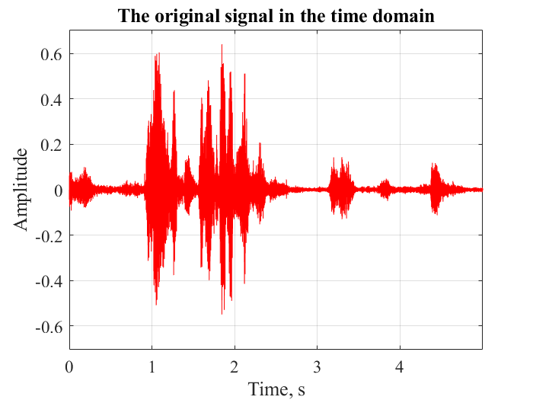
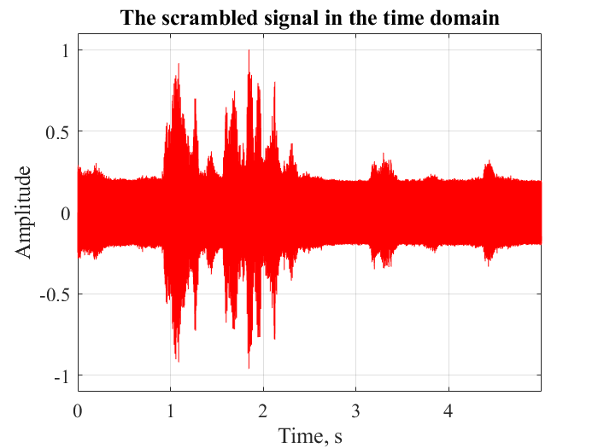
Time Domain Signal Comparison
Constant amplitude noise source
Peaks at similar times but slightly altered amplitudes
Notes:
Analysing the original and scrambles signal in the time domain
-Reveals constant noise source of large amplitude after being scrambled
-Peaks mostly occur in similar positions with slightly altered amplitudes

Slide 4
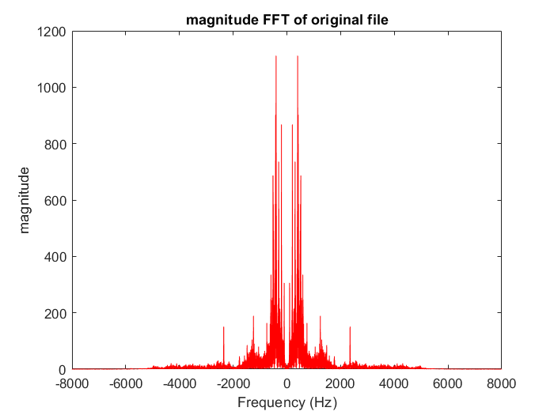
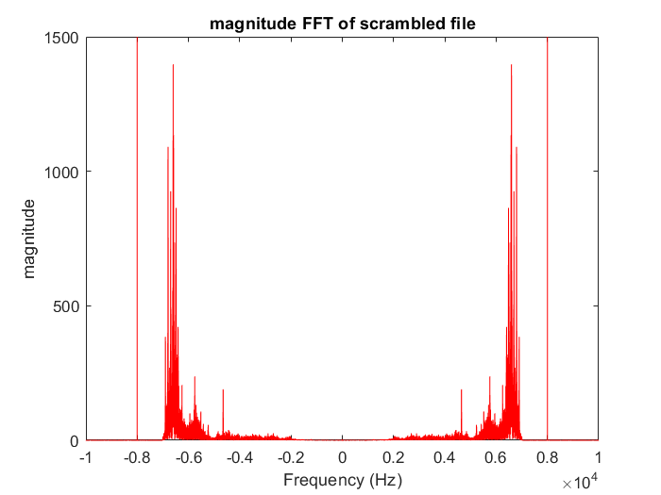
Frequency Signal Domain Comparison
Peak at 400Hz
Peak at 6600Hz
Notes:
Frequency shifted signal (about 7000Hz shift).
Frequency bands mirrored along y-axis.
Sharp peak of large magnitude at 8kHz corresponding to constant noise source.

Slide 5
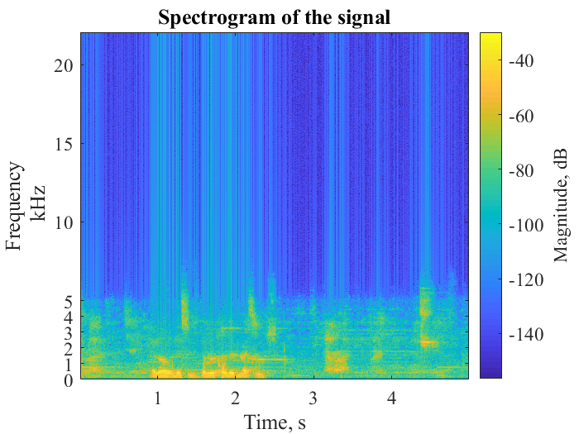
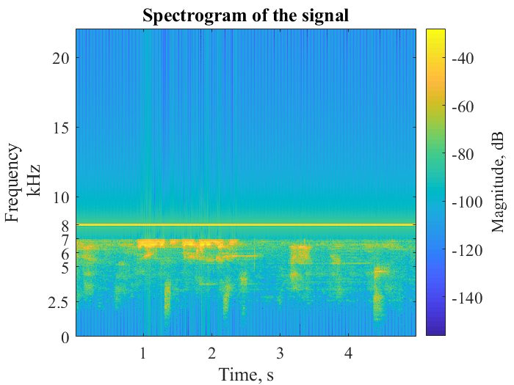
Frequency Domain Signal Comparison
Notes:
Confirms strong noise source is from this 8kHz band
-Confirms exact shift of frequency spectrum by 7kHz

Slide 6
Block Diagram
Scrambled Signal
Band-stop filter to remove the 8kHz frequency
Multiplying the signal with a 7kHz carrier signal to shift it in the time domain
Low pass filter to filter extra positive sideband leaving just our initial audio signal
Original Signal
Breadboard (Analogue)
Output
Input
MSP432 (Digital)
Notes:
Simplified block diagram for what is needed to be completed by the team throughout the week

Slide 7
General Flow Process of the Descrambler
Scrambled Signal → DC Biasing Circuit (External) → ADC (MSP) → BANDSTOP FILTER (MSP) → Signal Shifting (MSP)→ DAC (EXTERNAL) → LOW PASS -ANTI ALIASING- Filter (External) → Power Amplifier (External) → SPEAKER

Slide 8
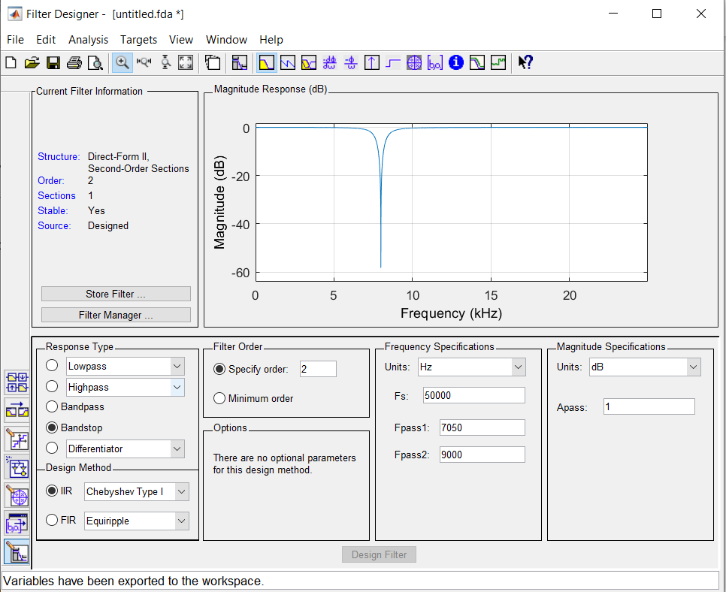
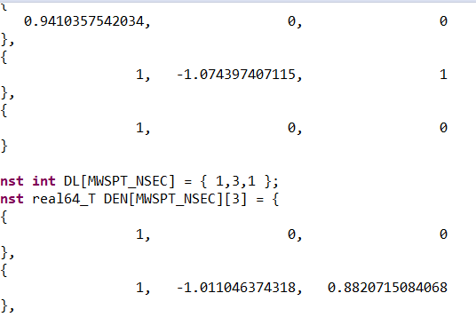
Analog-Digital-Converter
This input of the circuit transforms the 14-bit analog input from our aux into an 8-bit value that our MSP432 can then process and output. First, we must design our filter using ‘fdatool’ command in MATLAB. These output filter coefficients that we can use with our IIR digital filter design
B =
A =

Slide 9


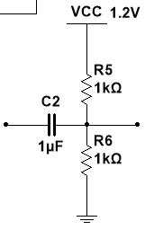

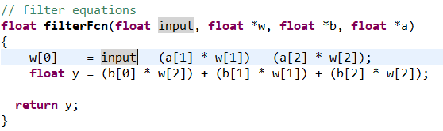
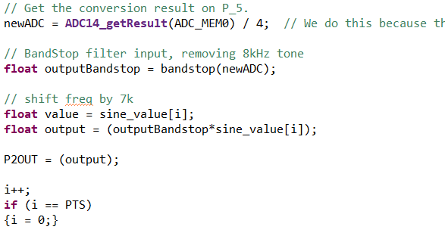
Analog-Digital-Converter
To perform real-time we create a circular buffer in the form of an array that stores our inputs and previous inputs relative to our outputs. We then perform the bandstop operation using our coefficients to filter out the 8kHz noise. We then multiply our signal by 7kHz to shift our frequency spectrum up
Notes:
Bias using the reference pin on the MSP by 0.6V to capture all parts of the input signal (MSP can only read positive integer values)

Slide 10
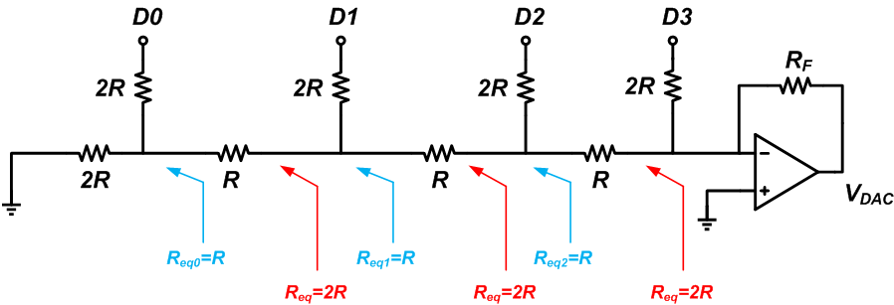
Digital-to-Analogue Converter (DAC)
Configuration used is a R-2R ladder DAC
Cascaded L-shaped networks of R and 2R – voltage supplied to each section can be calculated and summed (calculation using repeated reduction of left joints of the circuit into Thevenin equivalents)
Notes:
DAC converts our 8-bit output into a total analog voltage where each stage of the DAC corresponds to a ‘step’ in amplitude levels adding up to a total of 256 (8-bits)

Slide 11
Analogue Components
Low-Pass Anti-Aliasing Filter
Power Amplifier
Built with a cut-off frequency of 5kHz and designed to be third order therefore giving it a roll-off of -60dB/decade
Cuts off extra sideband that is present due to frequency shift
Signal is attenuated and distorted as it passes through the low-pass filter, leaving a weak signal
An amplifier which boosts the current of the signal paired with a voltage amplifier to boost volume of the speaker

Slide 12
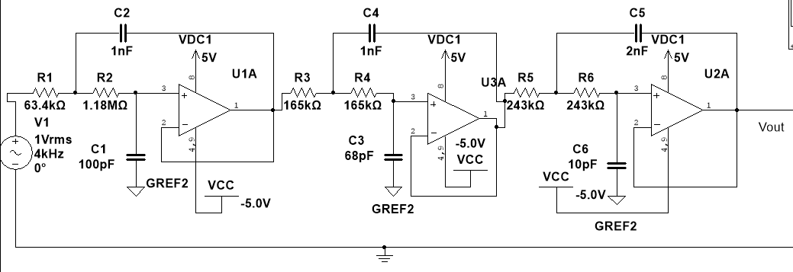

Low-Pass Anti-Aliasing Filter
Chebyshev Type II Filter with a ~0.29 dB ripple
Trade-off between complexity (number of stages) and accuracy (ripple in output voltage)
Consists of 3 cascaded Sallen-Key configurations
The Sallen-Key amplifier is an active filter with a voltage gain ~ inversely proportional to the square of the supplied frequency (quadratic function in the supplied frequency $ω→f$)
Is useful for both amplification of low frequency voltage signals
$\frac{V_{2}}{V_{1}}=\frac{\frac{K}{R_{1}R_{2}C_{1}C_{2}}}{s^{2}+\left(\frac{1}{R_{1}C_{1}}+\frac{1}{R_{2}C_{1}}+\frac{\left(1−K\right)}{R_{2}C_{2}}\right)s+\frac{1}{R_{1}R_{2}C_{1}C_{2}}}$
Derivation of this formula will show that identical imaginary components amplified by the gain block $K$ appear in both the numerator and denominator. Their impacts are ~equal and they can thus be neglected
Notes:
3rd order low pass filter circuit with 5kHz cut off to get rid of unwanted shifted sideband at 11kHz
Roll off of around -60dB/decade (very sharp)

Slide 13
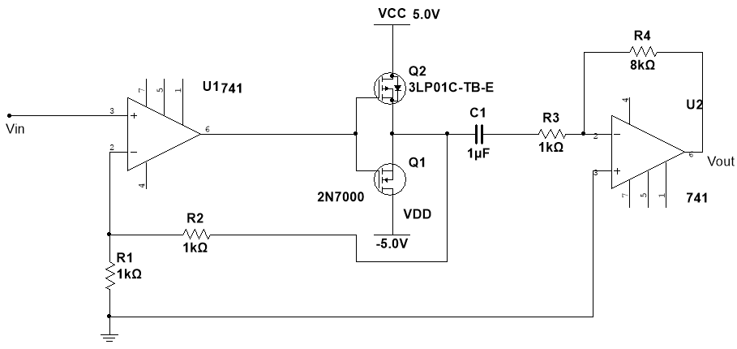
Power Amplifier
Comprises a non-inverting buffer op-amp configuration, a push pull amplifier and an inverting op-amp configuration cascaded in that order
Voltage amplification is achieved by the last op-amp configurations with a gain of 8.
The N channel FET provides power amplification for the positive part of the signal whilst the P channel FET amplifies the negative.
Notes:
Power amplifier circuit for speaker
Push – Pull FET transistor circuit used.

